Slide 1
Chapter 4
Leisure, Flow, Mindfulness, and Peak Performance

Slide 2
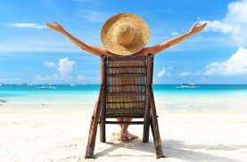
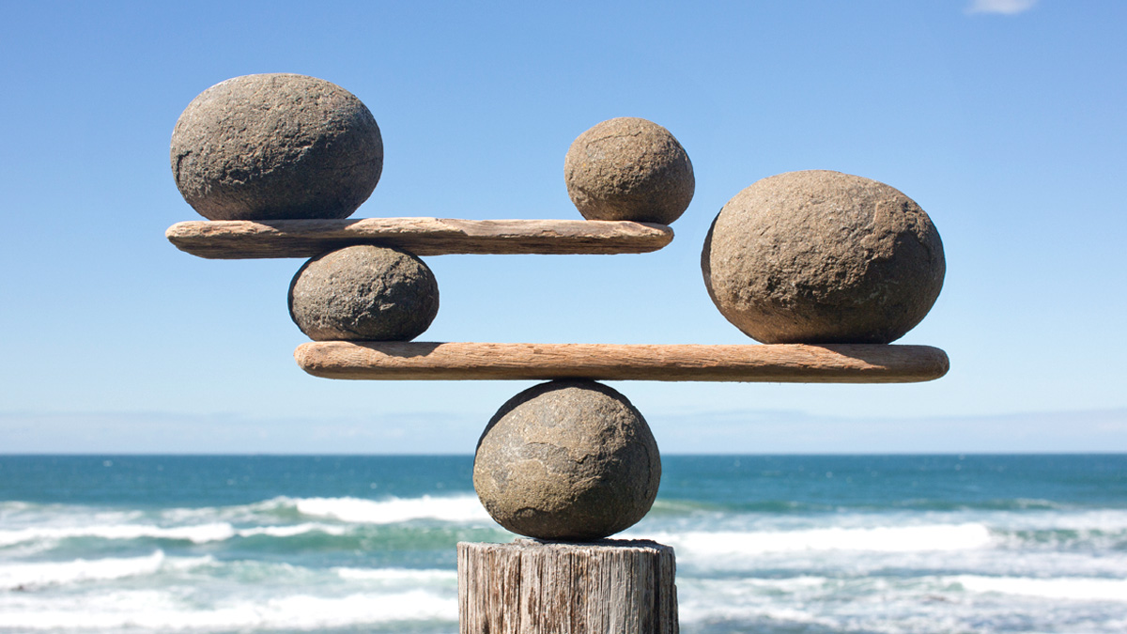
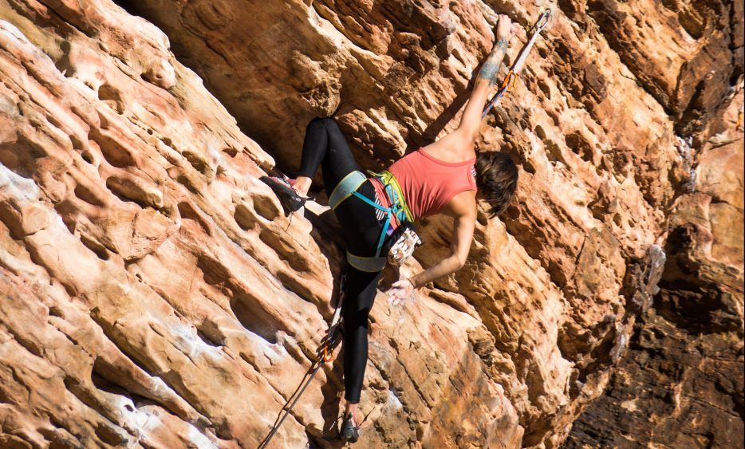
Leisure
Finding ways to amuse ourselves
Leisure activities…what do you enjoy?
Life satisfaction and well-being

Slide 3
Leisure
Leisure and Well-Being
Having more time is more important than having more money…time affluence
Variety of leisure activities and participation in active leisure activities…higher life satisfaction
Exercise, mindfulness meditation can decrease depression, anxiety
Associated with greater indices of well-being
Having leisure time does not automatically increase our well-being
Active
Meaningful
Life experiences (rather than making purchases)

Slide 4
Leisure
What Turns an Activity into “Leisure?”
Highest-ranked reasons
Fulfill needs for autonomy
Enjoyment of family life
Relaxation
Offers escape from routine
Important for a sense of well-being and life satisfaction
Notes:
Highest-ranked reasons: For engaging in leisure were that leisure--fulfilled needs for autonomy, allowed the enjoyment of family life, relaxation, offered an escape from routine.

Slide 5
Leisure
What Turns an Activity into “Leisure?”
Core Psychological Mechanisms
Detachment-recovery
Detach from responsibilities, recover from stress
Autonomy
Mastery
Meaning
Affiliation with others
Summary: Leisure is important for a sense of well-being and life satisfaction
Notes:
Highest-ranked reasons: For engaging in leisure were that leisure--fulfilled needs for autonomy, allowed the enjoyment of family life, relaxation, offered an escape from routine.

Slide 6
Flow and Optimal Experience
Definition of Flow
Flow: A state in which action follows upon action
aka in the zone
The holistic sensation
Percentage of people who have had very intense flow experiences is much smaller
Link between flow and psychological well-being

Slide 7
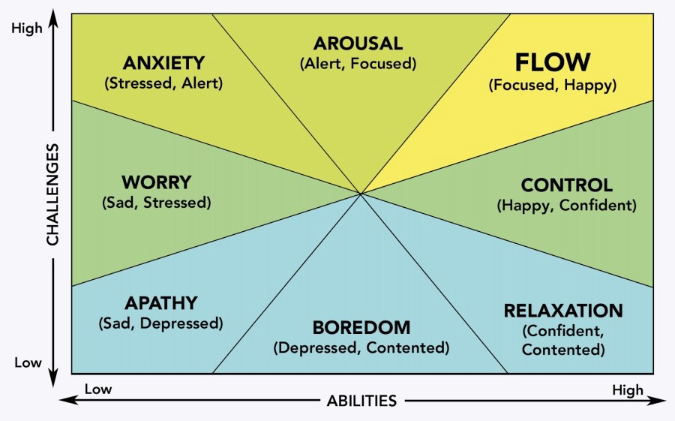
Flow and Optimal Experience
Characteristics of Flow
State of flow described using 8 parameters
Flow accompanies a challenging activity that requires skill
Notes:
State of flow can be described with eight parameters: Merging of action and awareness, complete concentration on the task at hand, lack of worry about losing control, a loss of self-consciousness, time no longer pass in ordinary ways, autotelic nature of the experience.

Slide 8
Flow and Optimal Experience
Characteristics of Flow
Merging of action and awareness
Intense and focused concentration
Greater sense of control
A loss of self-consciousness
Notes:
State of flow can be described with eight parameters: Merging of action and awareness, complete concentration on the task at hand, lack of worry about losing control, a loss of self-consciousness, time no longer pass in ordinary ways, autotelic nature of the experience.

Slide 9
Flow and Optimal Experience
Characteristics of Flow
5. Distortion of temporal experience
6. Autotelic nature of the experience (process is intrinsically motivating)
Conditions Under Which Flow is More Likely:
7. Challenge-skill
8. Activity provides clear goals and immediate feedback
Notes:
State of flow can be described with eight parameters: Merging of action and awareness, complete concentration on the task at hand, lack of worry about losing control, a loss of self-consciousness, time no longer pass in ordinary ways, autotelic nature of the experience.

Slide 10
Flow and Optimal Experience
Contexts and Situations of Flow
Contexts: religious rituals, teaching, family interactions, cramming, online learning, psychotherapy, military combat, sports, exercise, reading, music
Flow experiences may be the key to job satisfaction
Work engagement
Vigor
Dedication
Absorption
Allows people to enjoy life, feel happier, and function better

Slide 11
Flow and Optimal Experience
Contexts and Situations of Flow: Is Flow a State or a Trait?
If flow is a state
A state of consciousness that can occur to anyone with the same amount of effort given the right circumstances
If flow is a trait (dispositional flow)
There should be innate differences in how easily individuals can experience flow
Some twin research suggests flow proneness related to genetically linked personality traits of extraversion, agreeableness, and openness to experience

Slide 12
Flow and Optimal Experience
Flow and Subjective Well-Being
Research on flow began with asking people about moments of well-being
Study relationships between being in frequent flow experiences and increased well-being
Flow is a significant component of leisure activities, so in this way flow is related to leisure and satisfaction
Flow related to intrinsically motivated activities…keep repeated activities that produce flow (even though they receive no recognition or money to do so)

Slide 13
Flow and Optimal Experience
Flow and Subjective Well-Being: Measurement
Assessment questionnaire is designed to measure flow as a state or as a trait
Flow State Scale–2
Dispositional Flow Scale–2
Experience Sampling Method (ESM)
Notes:
Flow State Scale–2: The questions ask about what the person experienced “in the activity you just completed.”
Dispositional Flow Scale–2: The questions ask about experiences “in your chosen activity.”
Experience Sampling Method (ESM): Gathers information about a person’s experience immediately after he or she has it.

Slide 14
Flow and Optimal Experience
Comments on the Theory of Flow
Not all studies have supported the predictions of the flow theory
Flow experience is not always present in a specific activity
If flow activity is present, it may not be present throughout the duration of the activity
Flow is fostered by intrinsic interest in and curiosity about the task

Slide 15
Mindfulness
Conscious awareness
Open, receptive attitude
Impact telomerase activity and may thus optimize health and longevity
A tool applied in numerous areas to enhance well-being

Slide 16
Mindfulness
Meta-Analysis: Benefits of Mindfulness
Improving mental health
Better work performance
Improved student performance
Better health
Increased creativity
Improved weight loss
Enhanced athletic performance
Better financial reasoning

Slide 17
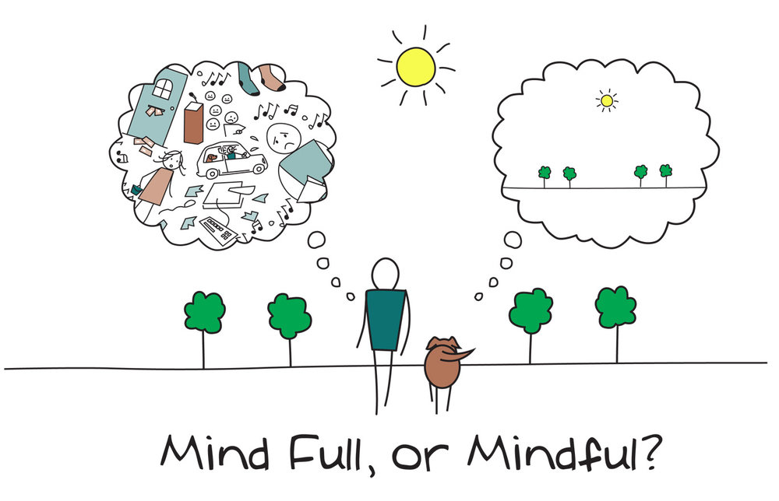
Mindfulness
Ellen Langer’s Approach to Mindfulness
Mindlessness
Automatic pilot
Roots in habits, premature cognitive commitments to categories, and focus on goals rather than on immediate processes

Slide 18
Mindfulness
Ellen Langer’s Approach to Mindfulness
Represents a cognitive style that centers on:
Awareness
Quality of attention in everyday experiences
Experience world with fresh eyes and ears

Slide 19
Mindfulness
Ellen Langer’s Approach to Mindfulness
Mindfulness is “a flexible state of mind—an openness to novelty, a process of actively drawing novel distinctions. When we are mindful, we are sensitive to context and perspective; we are situated in the present”

Slide 20
Mindfulness
Ellen Langer’s Approach to Mindfulness
Mindfulness comprises three core qualities
Create new categories of experience
Be open to new information
See more than one point of view

Slide 21
Mindfulness
Buddhist-Inspired Mindfulness

Slide 22
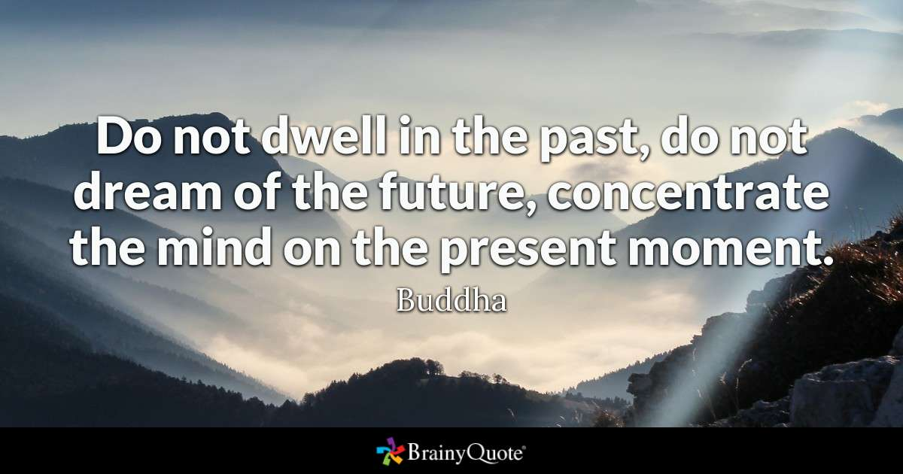

Slide 23
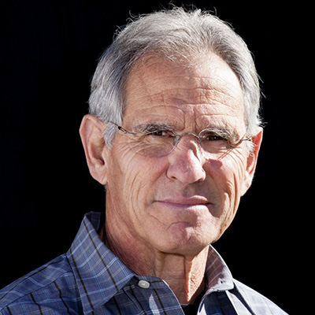
Mindfulness Jon Kabat-Zin
Professor Emeritus and creator of the Stress Reduction Clinic and the Center for Mindfulness in Medicine, Health Care, and Society at the University of Massachusetts Medical School
The practice has moved from a largely obscure Buddhist concept founded about 2,600 years ago to a mainstream psychotherapy construct today (apa.org)

Slide 24
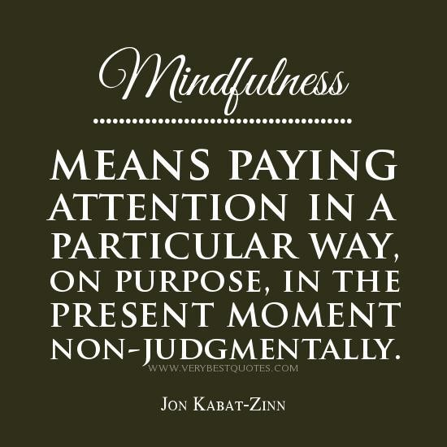

Slide 25
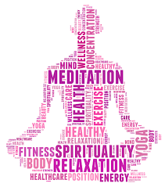
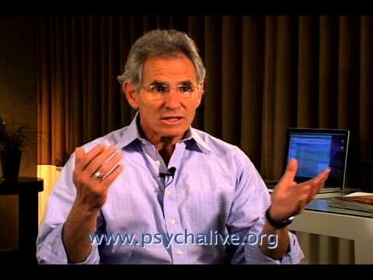
What is Mindfulness Jon Kabat Zinn

Slide 26
Mindfulness
Buddhist-Inspired Mindfulness
Meditative practices have included a practice called mindfulness
Buddhist-inspired style of mindfulness consists of three core elements:
Intention (commitment and dedication to meditation practice)
Attention (observing the contents of one’s experience)
Attitude (how a person pays attention to experience)
Notes:
Intention: Comprise commitment and dedication to meditation practice.
Attention: Observing the contents of one’s experience.
Attitude: Related to how a person pays attention to experience.

Slide 27
The Practice of Meditation
A way to come to experience more fully moment-by-moment existence by encountering the mind directly
Involves increasing awareness of the body (sensations), emotions, thoughts, the mind, and mental qualities
West, M.A. (2016). The practice of meditation. In The Psychology of Meditation: Research and Practice, Oxford University Press.

Slide 28
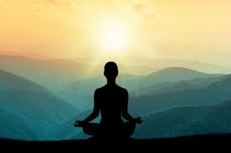
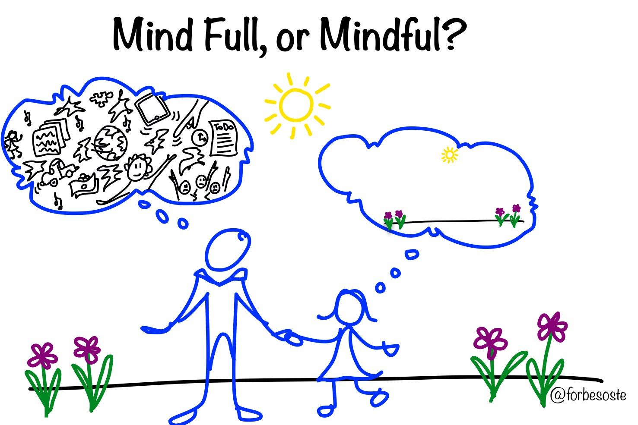
Mindfulness
Mindfulness Meditation
Daily Mindfulness

Slide 29
Aims of Meditation
To increase non-reactive awareness, though more acute to events and experiences
Meditation offers a means of opening to or connecting with all experience, whether positive, negative, or neutral in a (relatively) unfiltered, unprocessed way
To reduce suffering as a consequence of this greater openness, through reduced reactivity to experience and increasing well-being
West, M.A. (2016). The practice of meditation. In The Psychology of Meditation: Research and Practice, Oxford University Press.

Slide 30
John Kabat-Zinn Elements of Mindfulness Practice
Awareness
All possible experiences: sensations, thoughts, emotions, sights, sounds
Sustained Attention
Involves gently but firmly bringing attention back to the current moment
Focus on the Present Moment
Non-Judgmental Acceptance
Not labeling or reacting to experience as good/bad, desirable/undesirable
West, M.A. (2016). The practice of meditation. In The Psychology of Meditation: Research and Practice, Oxford University Press.

Slide 31

Mindfulness Meditation Basics
Take a good seat
Pay attention to the breath
When your attention wanders, return to your breath
(Simple, but not necessarily easy)

Slide 32

Breath Concentration Metaphor
We are trying to rest our attention on an object, such as our breath, and use it like an anchor of a boat
The anchor is there to ensure that the boat does not drift away but the boat is not motionless
So, we are not trying to stop thinking, feeling, or sensing
Trying to develop a different relationship to them by using the breath as an anchor to ensure that our thoughts do not carry us too far away from the present moment
Batchlor, M. (2016). Meditation: Practice and experience. In The Psychology of Meditation: Research and Practice. In West, M.A. (editor). Oxford University Press.

Slide 33
How Do I Begin?
Mindful.org Suggestions
Web Suggestions
Koru app or korumindfulness.org
Insight Timer
Aura
Omvana
Stop, Breathe, Think
Calm
The Mindfulness App
Headspace
MINDBODY
Buddhify
Smiling Mind
Meditation Timer Pro

Slide 34
Links
https://korumindfulness.org/
https://www.mindful.org/

Slide 35
Koru Guided Meditations
Breath Awareness
Belly Breathing
Body Scan
Gatha
Walking Meditation
Guided Imagery
Labeling Thoughts
Labeling Feelings

Slide 36
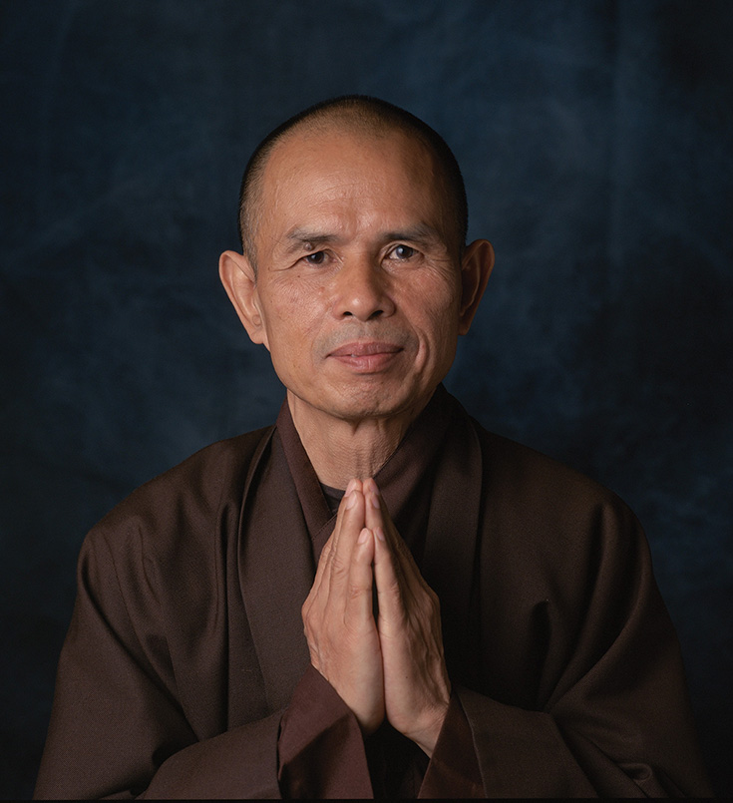
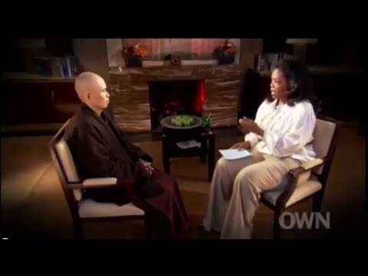
Thich Nhat Hanh

Slide 37
Mindfulness
Buddhist-Inspired Mindfulness: Why Does Mindfulness Increase Well-Being?
Increases a metacognitive perspective
Mindfulness allows decentering
Evaluate consciousness with less reactivity
Reduce intense reactivity to highly arousing and emotional stimuli
Processing of emotional material

Slide 38
Mindfulness
Langer Style
Buddhist Style
New knowledge gained from being more mindful is used to create new ways of thinking about one’s life
Increase happiness and life satisfaction by fostering a more stable and positive sense of self-identity
Awareness of ongoing experience while creating an attitude of calm detachment from the experience
Places greater emphasis on equanimity, peace of mind, contentment, and compassion (mainly by decreasing focus on self-identity)

Slide 39

Savoring
Awareness of pleasure and focus attention on the sensation and delight in it

Slide 40
Savoring
Four basic types of savoring:
Basking
Receiving praise and congratulations
Marveling
Getting lost in the wonder of a moment
Luxuriating
Indulging in a sensation
Thanksgiving
Expressing gratitude

Slide 41
Savoring
Five Ways to Enhance/Promote Savoring
Absorption
Sharpening the senses
Memory building
Take pictures, buy souvenirs
Sharing with others
Self-congratulation

Slide 42
Peak Performance
Performing in flow does not always translate into better performance
Peak performance: Performing beyond our normal level of functioning
Notes:
Peak performance can be described by four parameters:
Clear focus on self, object, and relationship.
Intense involvement in the experience.
A strong intention to complete a task.
A spontaneous expression of power.

Slide 43
Peak Performance
Peak performance can be described by four parameters
Clear focus on self, object, and relationship.
Intense involvement in the experience.
A strong intention to complete a task.
A spontaneous expression of power.
Notes:
Peak performance can be described by four parameters:
Clear focus on self, object, and relationship.
Intense involvement in the experience.
A strong intention to complete a task.
A spontaneous expression of power.

Slide 44
Peak Performance
Peak Performance in Sports
Being in flow does not necessarily have a peak performance
Key to peak performance
Is to maintain a clear focus on both self and object and maintain a strong sense of self in relationship with the object. Peak performance is most often found in activities that a person is deeply involved, committed, absorbed, or emotionally connected with.
Notes:
Key to peak performance: Is to maintain a clear focus on both self and object and maintain a strong sense of self in relationship with the object. Peak performance is most often found in activities that a person is deeply involved, committed, absorbed, or emotionally connected with.

Slide 45
Peak Performance
Peak Performance in Sports:
Peak Performance in Elite Athletes
Garfield and Bennet found eight conditions when actual performance was at its best
90% of athletic success may be due to psychological factors

